Slide 1
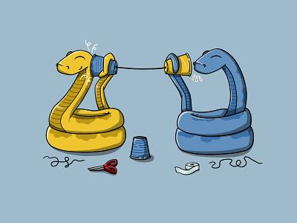
Intro to Python
(speedrunning COMP 210 🏃‍♀️🏃‍♀️🏃‍♂️🏃‍♂️💨)
QFA 2024

Slide 2
About Me (in case u forgot):
Name: Aaron
Major: Computer Science
Experience/Qualifications:
blah blah blah
trust me bro

Slide 3
Quick survey:
Who has python experience?
0-3 months (i.e. 1 semester class)?
4-6 months?
7+ months? (this lesson will be very boring)

Slide 4
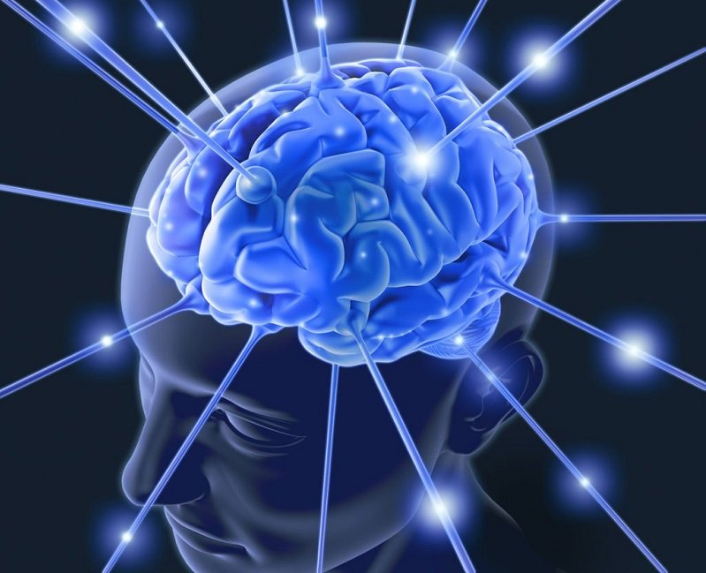
Brain Teaser Time:

Slide 5
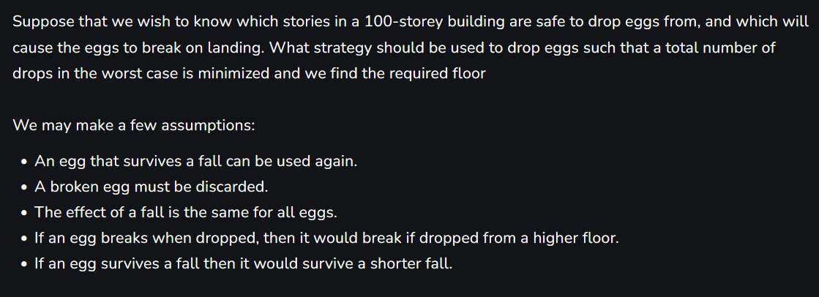
Brain Teaser Time:

Slide 6
What is Algorithmic Trading?

Slide 7
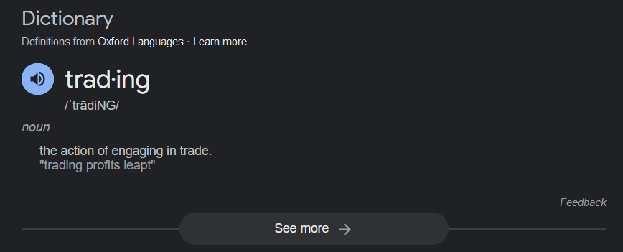
What is Trading?
Simplest terms: selling and buying stuff on the stock market
More complex terms:
Bidding on shares, futures offers at exchanges
Betting on performance, or lack thereof
Offering owned shares on the market

Slide 8
What are Algorithms (in trading)
Algorithms perform predefined tasks
Take arguments, parameters, data, etc
Create output
Trading algorithms
Get data from Exchange APIs
Analyze data
Calculate best actions,
Recommend actions to traders
Execute actions automatically

Slide 9
Common Trade Algorithms
Execution Algorithms:
Usually for large scale orders
Aid in re-allocating money from one asset to another
Might space out trades, attempt to reduce impact on price during executions
End goal is to reduce fluctuation in transaction pricing

Slide 10
Common Trade Algorithms
Behavior Exploitative Algorithms:
a.k.a. “I know your next move”
Analyze major opponents in the same market
How do they trade?
Can we reverse engineer their algorithms?
Deduce the rules behind trades
Probe for edge cases that break these rules
Utilize these cases to profit from opponents

Slide 11
Common Trade Algorithms
Scalping Algorithms:
Small, but fast
Focus on tiny differences in offers and bids
Must be quick in order to turn profits
Crowded market
Must also gracefully liquidate assets to minimize loss

Slide 12
Common Trade Algorithms
Predictive Algorithms:
Attempt to predict/model the future prices of stocks using past information, new information, and other second-order information
Fall into several subcategories:
Mean reversion
Trend following
Chart pattern recognition
Fundamental analysis
and more…

Slide 13
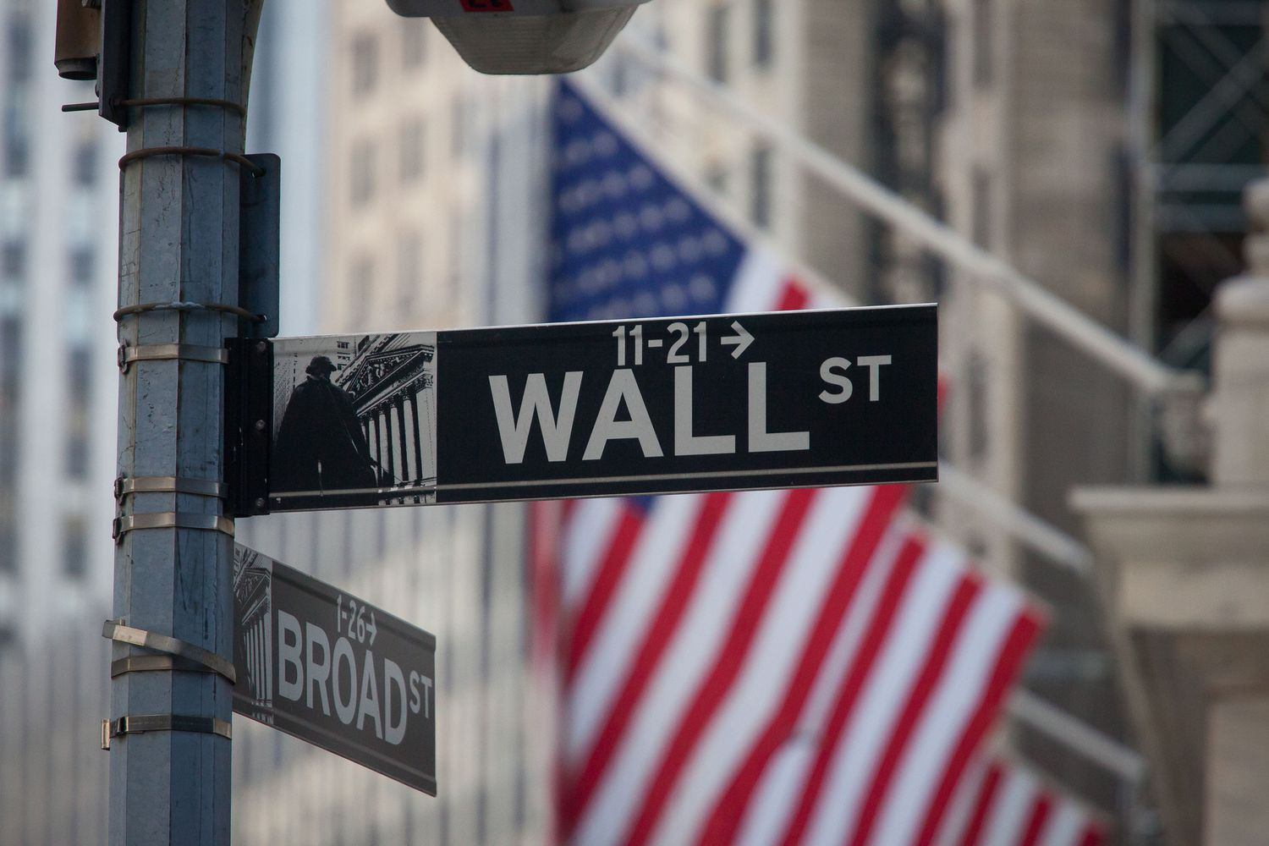
Who uses this?

Slide 14
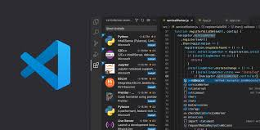
Languages + Tools
TF is this resolution??????

Slide 15
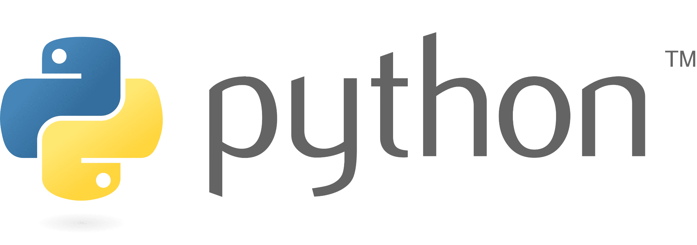
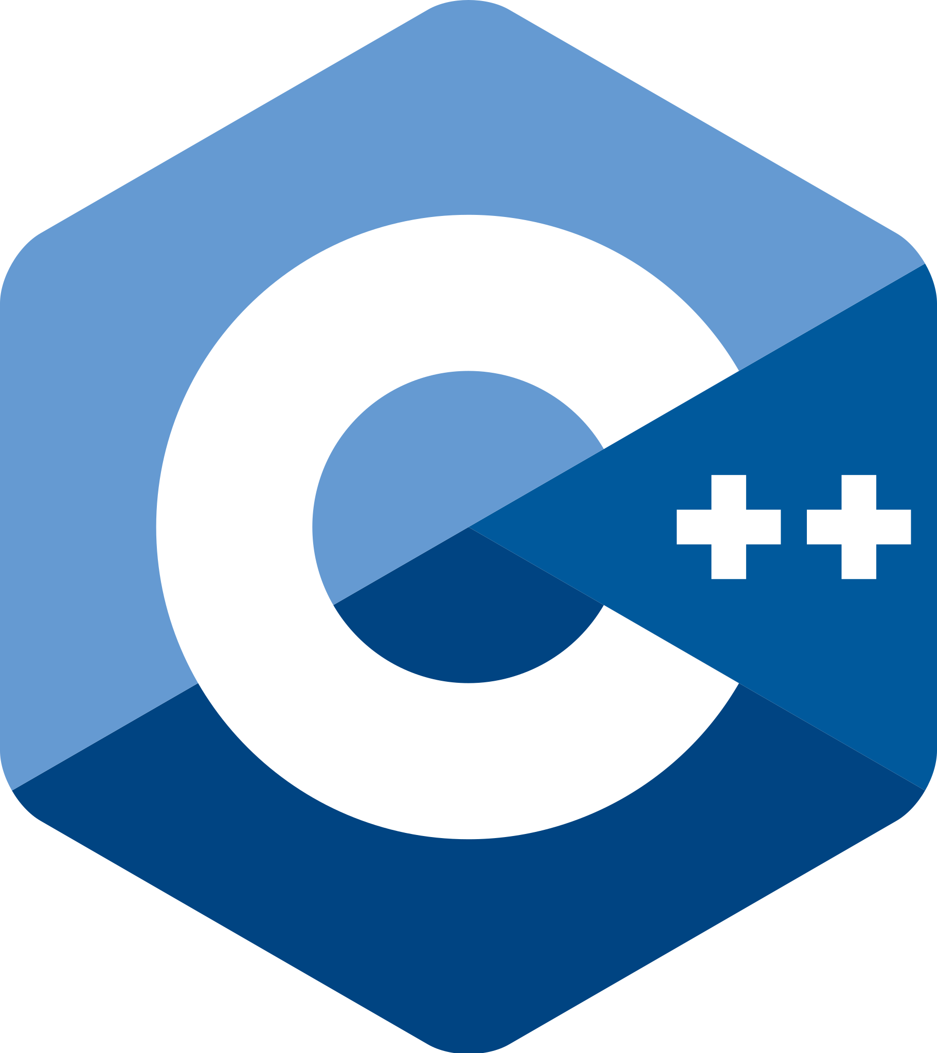
Python and C++
Both very common in many industries
Python:
Much more beginner friendly
Development is simpler
Very slow in execution
C++:
Very steep learning curve
High optimization potential + margins
(i.e. can be very fast)

Slide 16
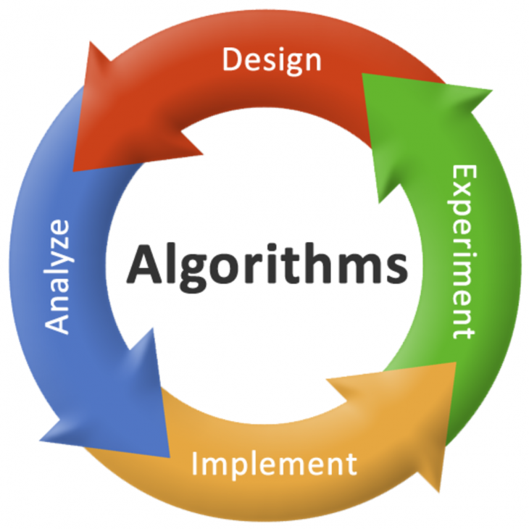
Algorithm Design

Slide 17
High-level Questions to Consider
What problem are we solving?
How long do we have to develop a solution?
What response time constraints does this algorithm have?
What libraries (of code) can we use?
Has anyone else already made a solution?
If so, is theirs a good one and can we use it?

Slide 18
Low-level Questions to Consider
What should be our runtime complexity (big O)?
What will our code depend on (libraries, dependencies, etc.)
How will we test our algorithm?
Unit tests?
Integration testing?
Field testing?

Slide 19
Let’s Design A (simple) Algorithm!

Slide 20
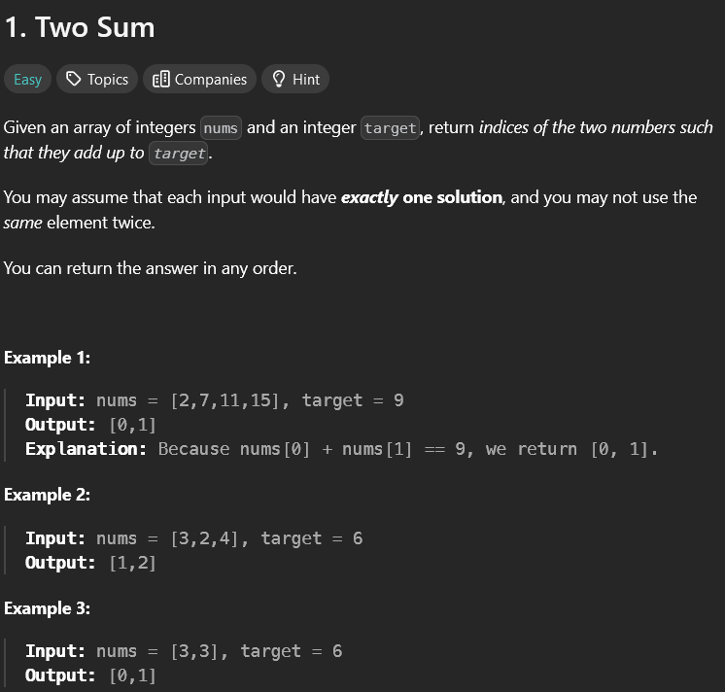
The Problem:
Found at: https://leetcode.com/problems/two-sum/

Slide 21
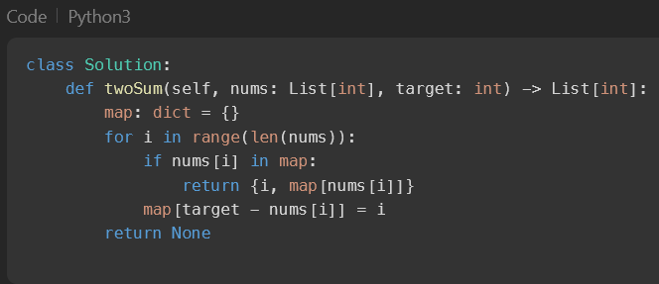
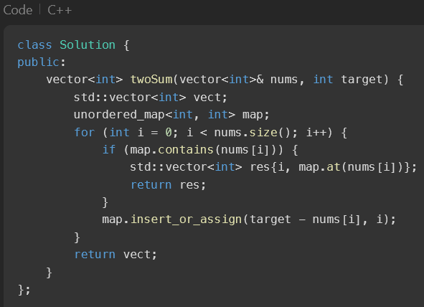
Python vs. C++

Slide 22
Next CS lesson:
Intro to Python

Slide 23
Thank you for attending!

