Slide 1
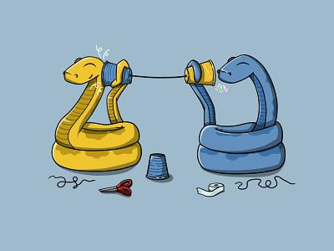
Intro to Python
(speedrunning COMP 110 🏃‍♀️🏃‍♀️🏃‍♂️🏃‍♂️💨)
QFA 2024

Slide 2
About Me (in case u forgot):
Name: Aaron
Major: Computer Science
Experience/Qualifications:
  blah blah blah
  trust me bro

Slide 3
Quick survey:
Who has python experience?
  0-3 months (i.e. 1 semester class)?
  4-6 months?
  7+ months? (this lesson will be very boring)

Slide 4

Brain Teaser Time:

Slide 5
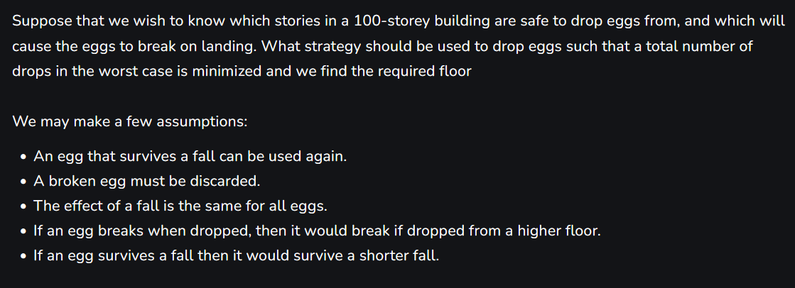
Brain Teaser Time:

Slide 6
setting up snek (s.u.s. for short)
(I know that meme died 4 years 5 years ago please laugh anyway)

Slide 7
Step 1: Download Python
Download Python from here:
  www.python.org
Technically now you can program using python! (if you enjoy suffering)
(alternatively you could use google colab instead)

Slide 8




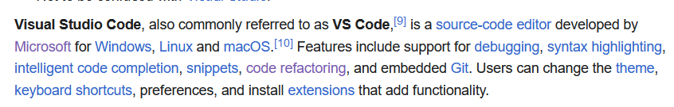

Step 2: Download a Source Code Editor
Download from this link:
  https://code.visualstudio.com/
Why is Visual Studio Code/VSCode good?

Slide 9
Baby’s first program:
Hello World

Slide 10
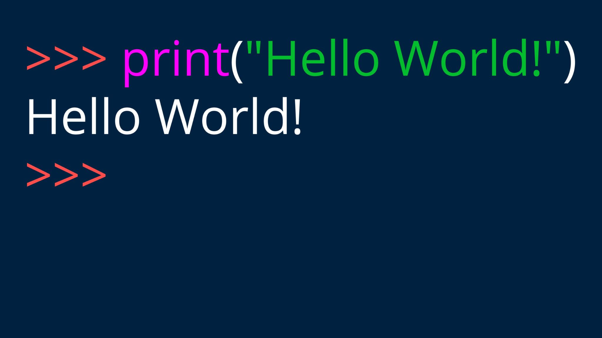

Slide 11
No, seriously, that’s it.

Slide 12

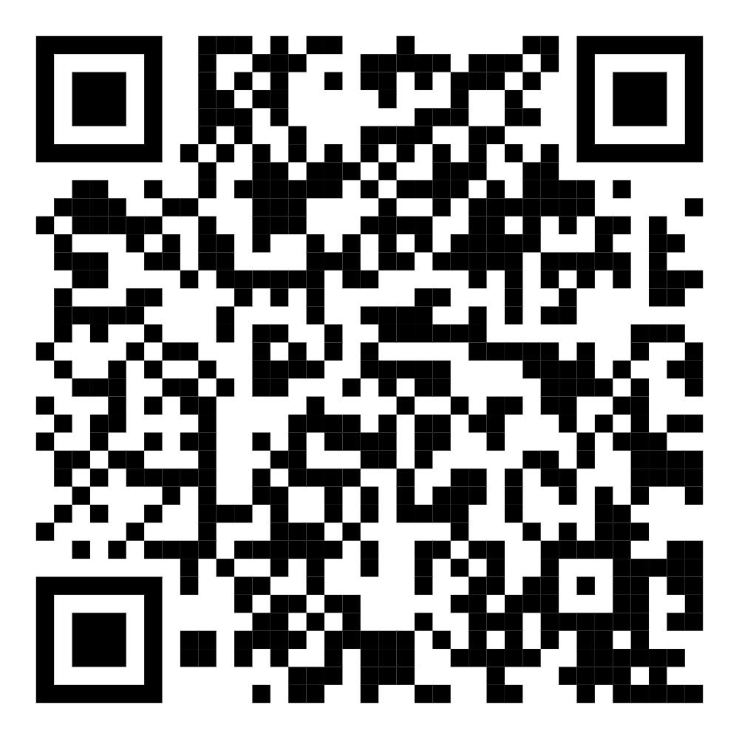
Thank you for attending!
Attendance for Points:

