Slide 1
Options 201 – Strategies and Greeks

Slide 2
Brain Teaser
I'm driving out to a resort, which is pretty far away. Luckily,
the first three quarters of the distance is all highway
driving, but I have to drive the rest on slower local roads. I
drive at 60 mph on the highway, but only 20 mph on local
roads. What's my average speed for this trip?

Slide 4
Review – What is an option?
Options are contracts between two traders who agree to certain conditions under which they are allowed/required to buy/sell stock over a prearranged time frame. These contracts are exchange traded
Calls are agreements where the buyer has the right but not the obligation to buy a security at a specific strike price, as such the seller is required to sell the security to the buyer at that price if the buyer exercises their rights under the option agreement
Puts are agreements where the buyer has the right but not the obligation to sell a security at a specific strike price, as such the seller is required to buy the security from the buyer at that price if the buyer exercises their rights under the option agreement
Notes:
Options r always packaged to 100.
Make not of American vs euros also interesting other things ppl do with this like Asian options which payout the average price over the time period
Questions:
does it make sense to exercise an option early? When does it make sense to do so.
Lets say expiry day has come, so the past question is now irrelevant, when does it make sense to use your option. When does it not make sense?

Slide 5
Review – Payoff Diagrams
Notes:
Notice that there is limited loss, why is this?
This is from the buyers perspective, what about from the seller’s perspective.
In this picture, how much did we pay per option (not per 100), what is the strike price? What would my pnl be if the stock was trading at 41? Where is my breakeven point?
What is the trick for finding breakevens (add per contract price to strike price = breakeven).

Slide 6
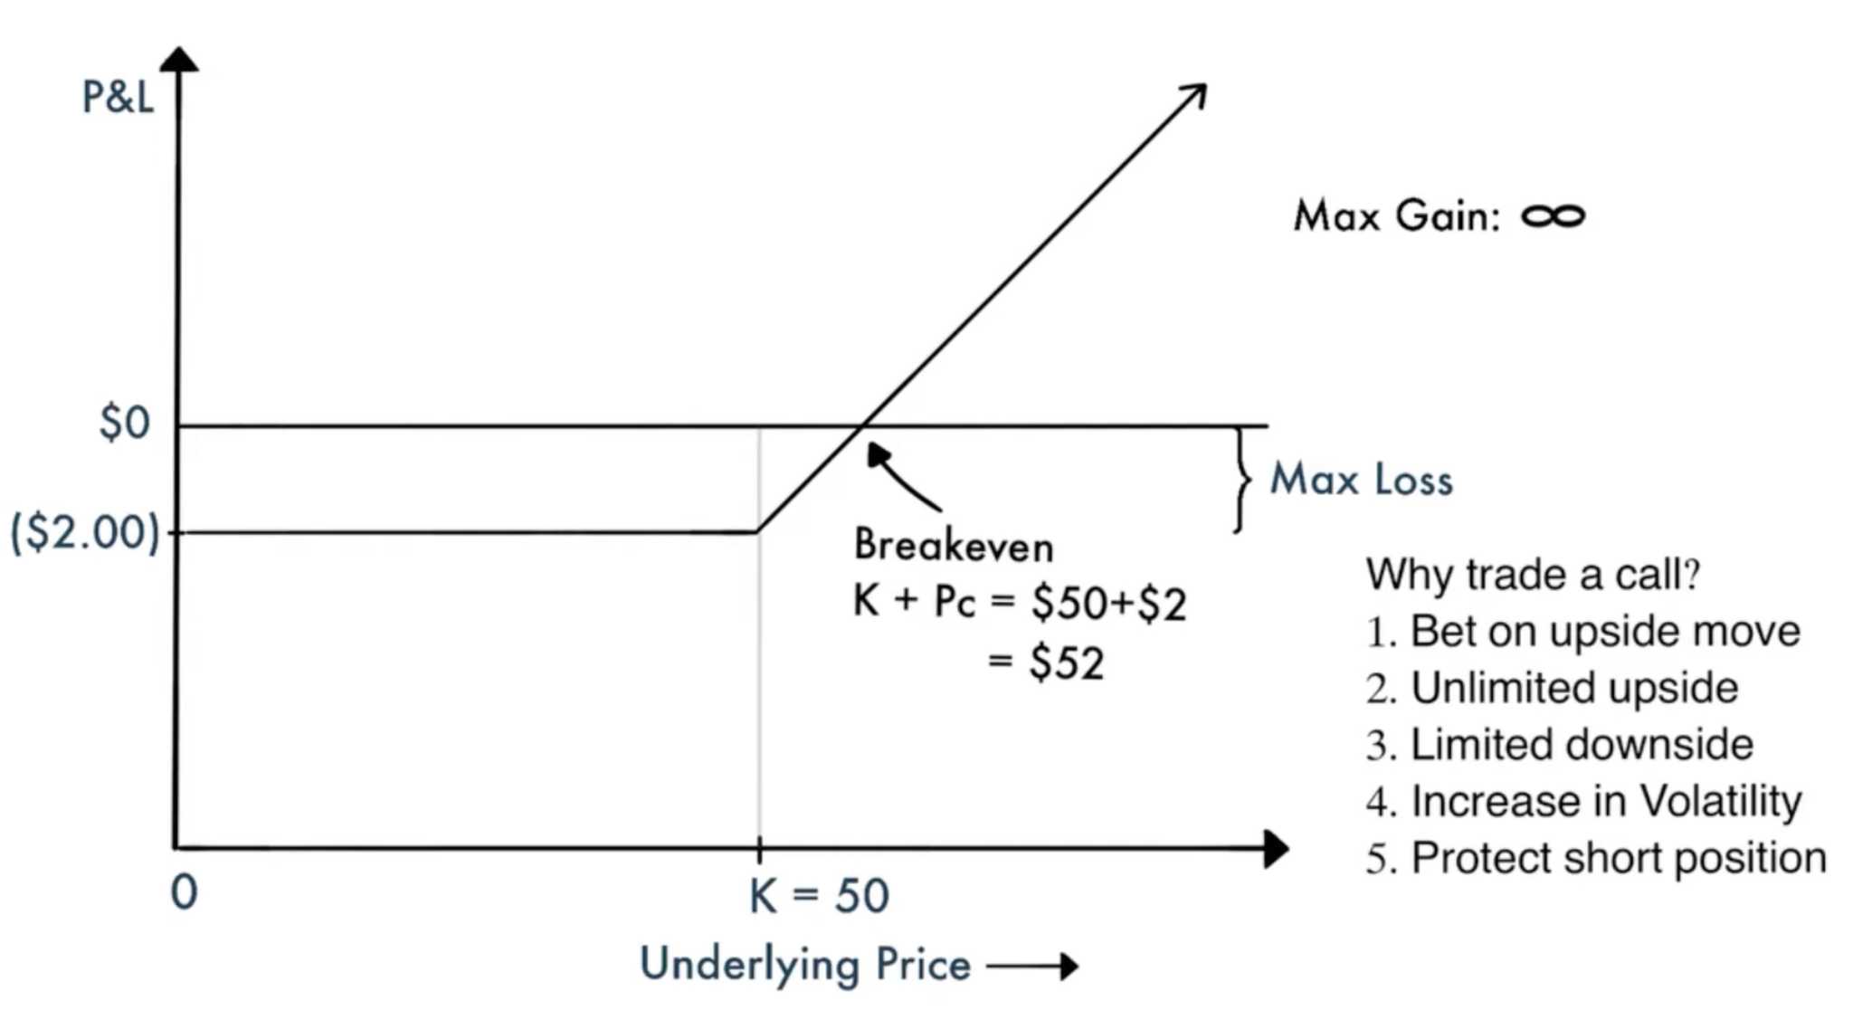
Review – Payoff Diagrams
Notes:
Notice that there is limited loss, why is this?
This is from the buyers perspective, what about from the seller’s perspective.
In this picture, how much did we pay per option (not per 100), what is the strike price? What would my pnl be if the stock was trading at 41? Where is my breakeven point?
What is the trick for finding breakevens (add per contract price to strike price = breakeven).

Slide 7
Review – Payoff Diagrams
Notes:
Notice that there is limited loss, why is this?
This is from the buyers perspective, what about from the seller’s perspective.
In this picture, how much did we pay per option (not per 100), what is the strike price? What would my pnl be if the stock was trading at 41? Where is my breakeven point?
What is the trick for finding breakevens (add per contract price to strike price = breakeven).

Slide 8
Review – Payoff Diagrams
Notes:
Unlimited loss/risk. Why would someone buy these? because you are on credit, you don’t need to put money down upfront for this position. Also for hedging, selling covered calls = income.

Slide 9
Review – Payoff Diagrams
Notes:
Unlimited loss/risk. Why would someone buy these? because you are on credit, you don’t need to put money down upfront for this position. Also for hedging, selling covered calls = income.

Slide 10
Payoff Diagrams - Call Spreads
Notes:
Unlimited loss/risk. Why would someone buy these? because you are on credit, you don’t need to put money down upfront for this position. Also for hedging, selling covered calls = income.

Slide 11
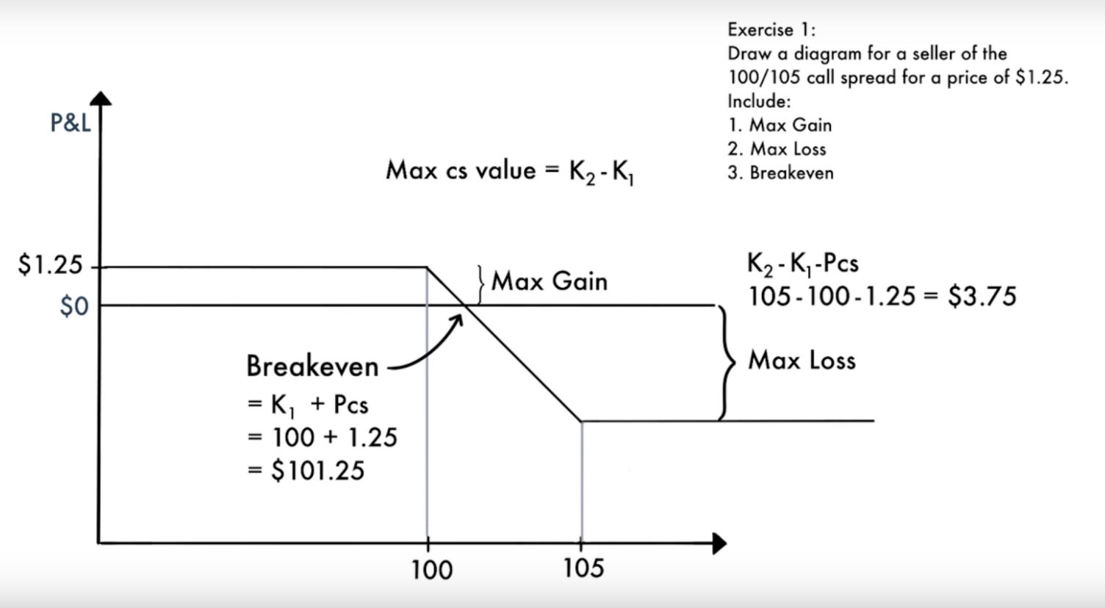
Payoff Diagrams - Call Spreads
Notes:
Unlimited loss/risk. Why would someone buy these? because you are on credit, you don’t need to put money down upfront for this position. Also for hedging, selling covered calls = income.

Slide 12
Payoff Diagrams - Put Spreads
Notes:
Unlimited loss/risk. Why would someone buy these? because you are on credit, you don’t need to put money down upfront for this position. Also for hedging, selling covered calls = income.

Slide 13
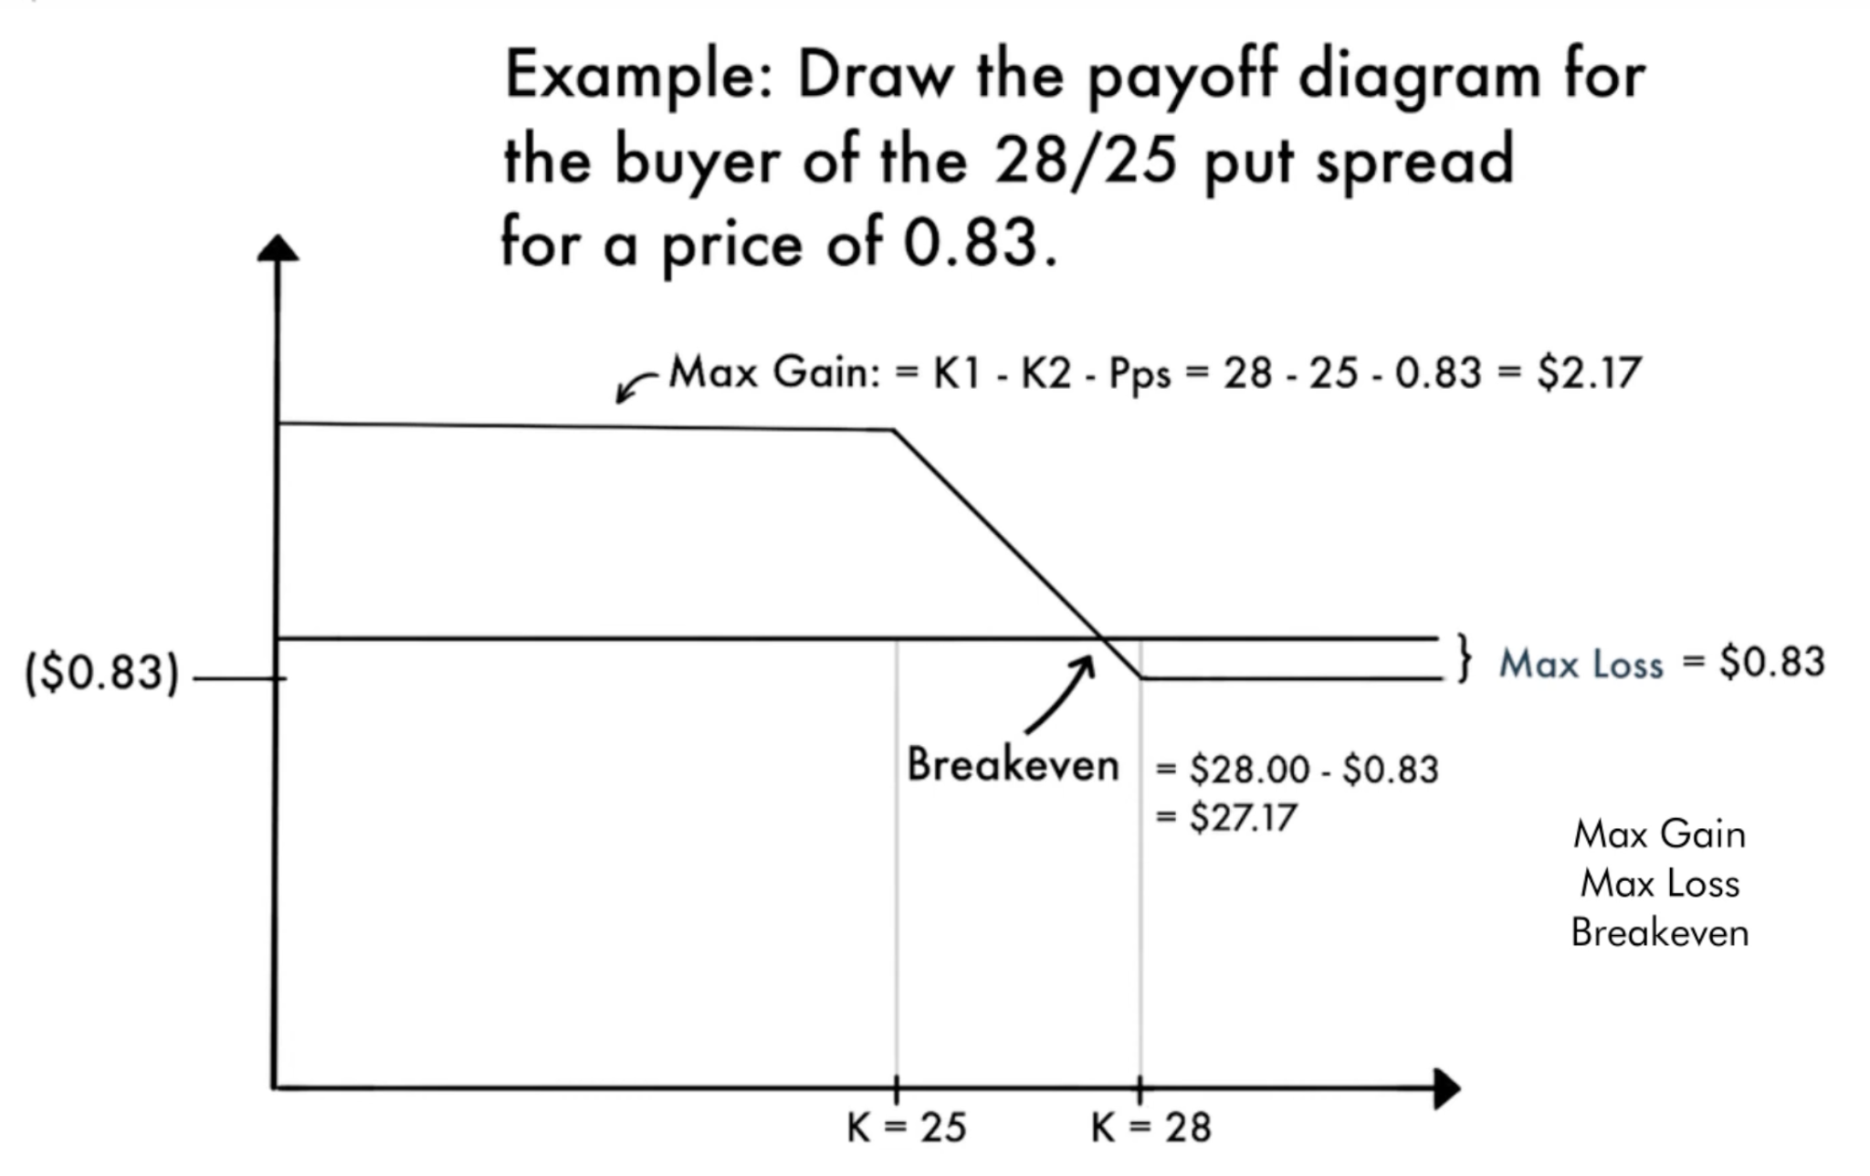
Payoff Diagrams - Put Spreads
Notes:
Unlimited loss/risk. Why would someone buy these? because you are on credit, you don’t need to put money down upfront for this position. Also for hedging, selling covered calls = income.

Slide 14
Payoff Diagrams - Put Flies
Notes:
Unlimited loss/risk. Why would someone buy these? because you are on credit, you don’t need to put money down upfront for this position. Also for hedging, selling covered calls = income.

Slide 15
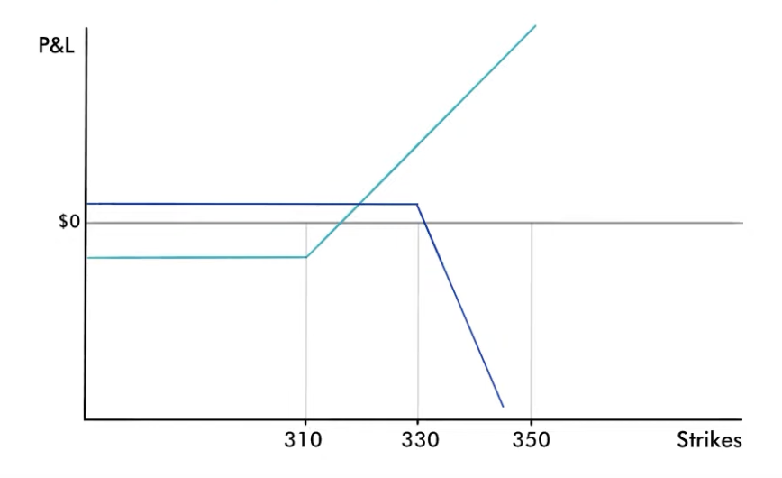
Payoff Diagrams - Put Flies
Notes:
Unlimited loss/risk. Why would someone buy these? because you are on credit, you don’t need to put money down upfront for this position. Also for hedging, selling covered calls = income.

Slide 16
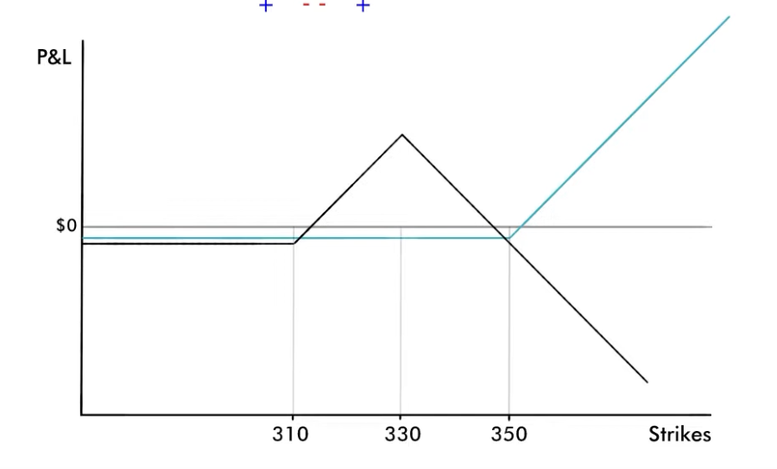
Payoff Diagrams - Put Flies
Notes:
Unlimited loss/risk. Why would someone buy these? because you are on credit, you don’t need to put money down upfront for this position. Also for hedging, selling covered calls = income.

Slide 17
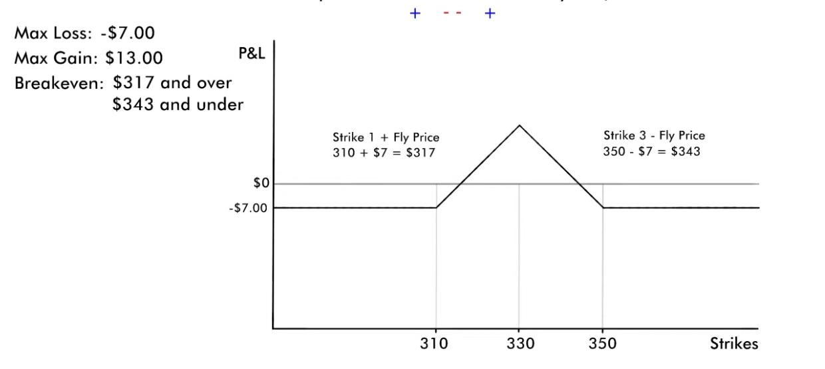
Payoff Diagrams - Put Flies
Notes:
Unlimited loss/risk. Why would someone buy these? because you are on credit, you don’t need to put money down upfront for this position. Also for hedging, selling covered calls = income.

Slide 18
Review - Moneyness
Moneyness relates to how far above/below the strike price the underlying (and thus the option) is.
Out of the money (OTM) means that the underlying spot price (share price of the stock itself) is away from the share price towards the worthless direction (if the option expired today, it would be $0).
In the money (ITM) means that the underlying spot price (share price of the stock itself) is away from the share price towards the valuable direction (if the option expired today, it would still have intrinsic value).
At the money (ATM) means that the spot price is exactly at the options strike price (can think of this as between ITM and OTM).

Slide 19
Intrinsic vs Extrinsic Value
The Value of an option changes over time depending on a host of factors, we can divide this value into two components:
Intrinsic Value is simply what the option would be worth if we were to exercise it at this exact moment (i.e. the actual pnl you would make).
Extrinsic Value is the remainder of an options value besides the intrinsic value, this includes mainly time value of an option.
Extrinsic Value can also be thought of as the difference in the intrinsic value of an option (the value you know you can extract by exercising it), vs the price the option is trading at.
Notes:
For example, if I have a stock trading at $50 and a call with a strike price of $40, the intrinsic value of that option is $10. i.e. if I exercised it right now I would make $10, but does this mean that it is trading for 10 dollars. If it was

Slide 20
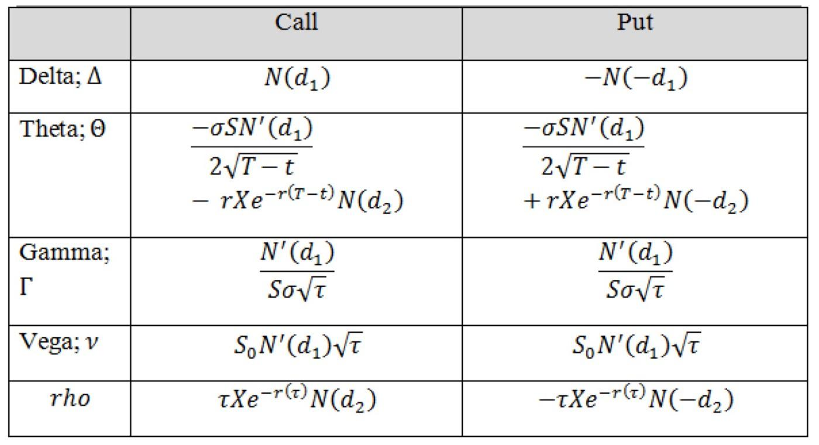
Black Scholes - Greeks
The greeks are a set of partial derivatives which describe the effect of different :

Slide 21
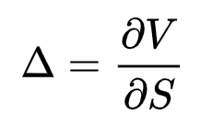
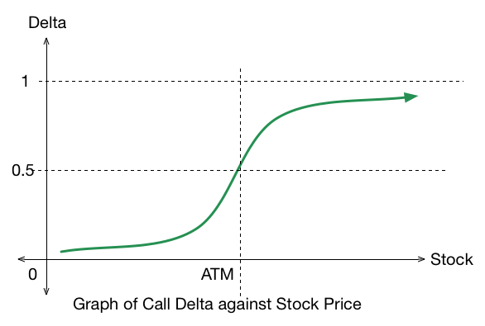
Greeks - Delta
Delta is the Change in the Price of an Option Relative to a $1 Movement in Spot.
Notes:
An ATM call has 0.5 delta, intuitively this is because it has a 50% chance of ending up ITM or OTM (in practice the reasoning is more complex)

Slide 22
Greeks - Delta
The delta of an option is the sensitivity of an option price to changes in the price of an underlying asset. Delta will tell us how much the price of the option (or option strategy) will change as the underlying changes.
Finally, delta can be defined as the probability that an option will expire ITM. E.g. a 0.4 (or 40) delta call is considered to have a 40% chance of finishing ITM.
Notes:
An ATM call has 0.5 delta, intuitively this is because it has a 50% chance of ending up ITM or OTM (in practice the reasoning is more complex)

Slide 23
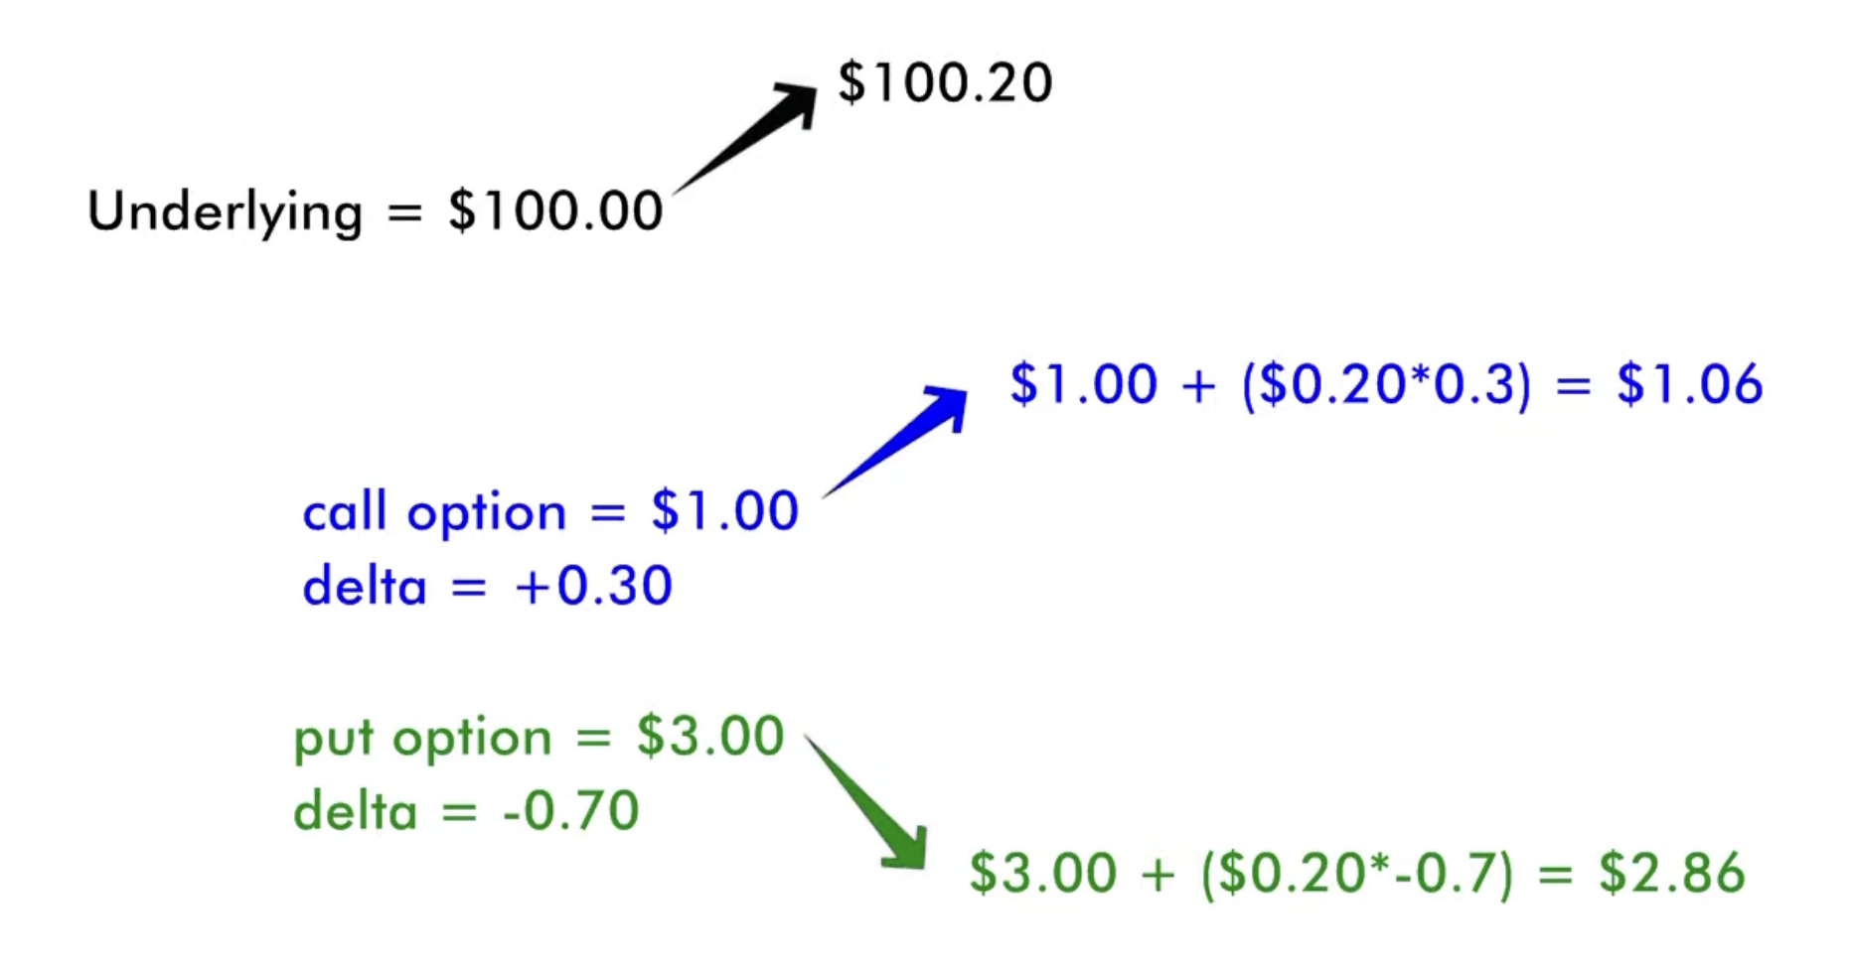
Greeks - Delta
Notes:
An ATM call has 0.5 delta, intuitively this is because it has a 50% chance of ending up ITM or OTM (in practice the reasoning is more complex)

Slide 24
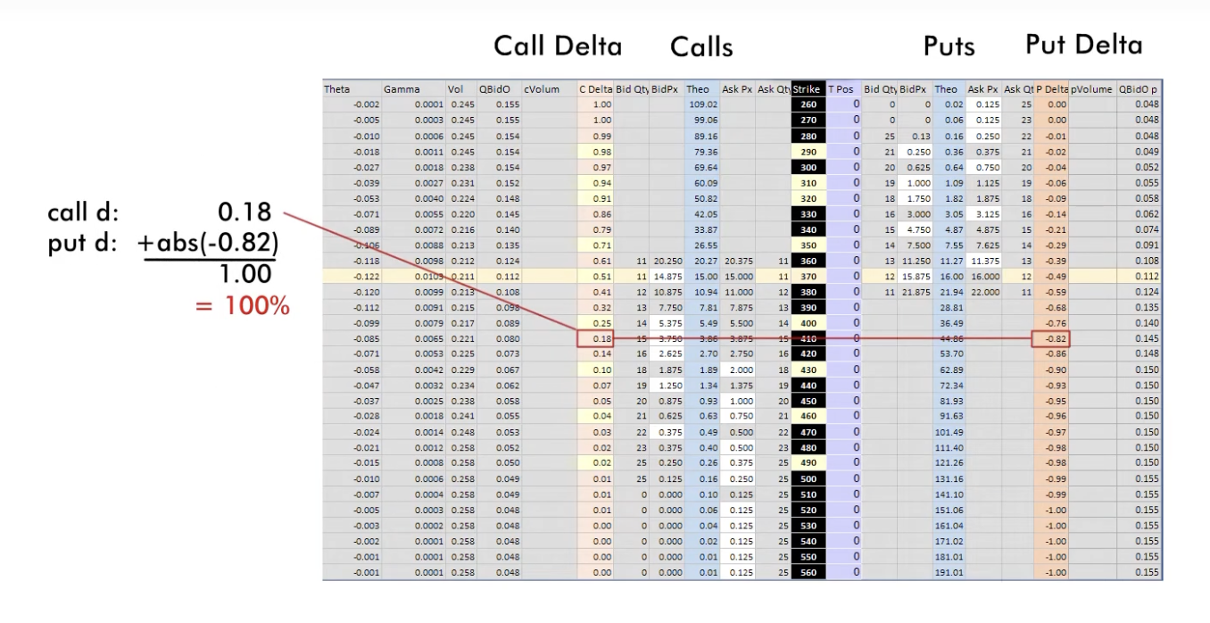
Greeks - Delta
Notes:
An ATM call has 0.5 delta, intuitively this is because it has a 50% chance of ending up ITM or OTM (in practice the reasoning is more complex)

Slide 25
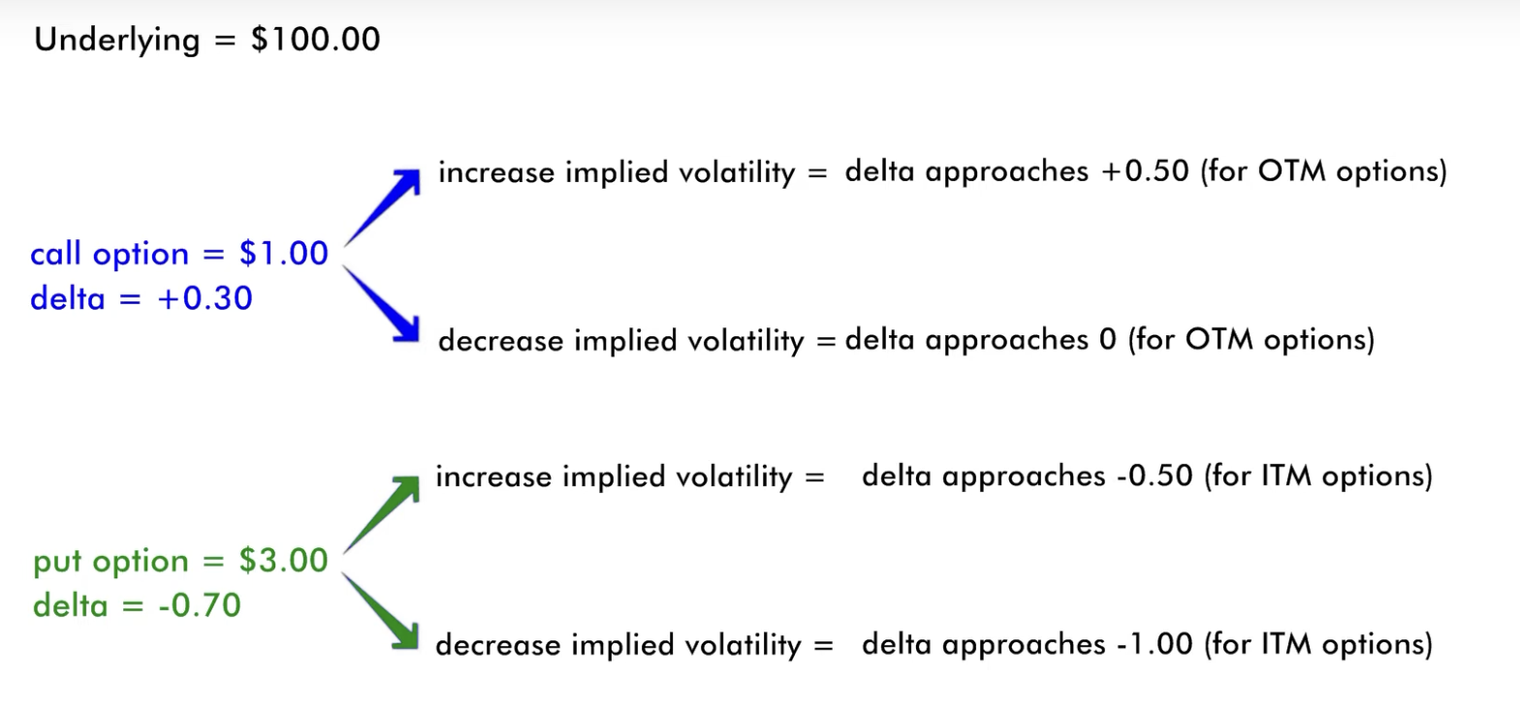
Greeks - Delta
Notes:
An ATM call has 0.5 delta, intuitively this is because it has a 50% chance of ending up ITM or OTM (in practice the reasoning is more complex)

Slide 26
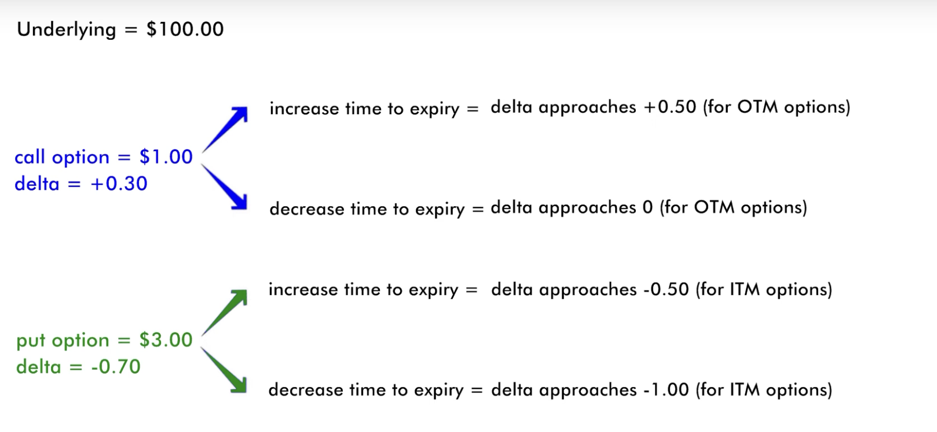
Greeks - Delta
Notes:
An ATM call has 0.5 delta, intuitively this is because it has a 50% chance of ending up ITM or OTM (in practice the reasoning is more complex)

Slide 27
Deep Dive – Implied Volatility
Implied Volatility is a value dependent on current options black Scholes prices for those options. As we know there are 5 inputs to BSM (spot, strike, expiry, rates, and vol), if we know 4 of these and the market price, we can derive an inverse function to imply the 5th
In practice this derivation is only really done for volatility hence why we call it ”implied volatility” as we are implying it from BSM.
This volatility is forward looking as it is attached to a strike and expiry date. It is quoted in percent terms where the percent corresponds to a 1 std dev move in price. For example, if spot is $100 and IV is 10% a 1 std dev move in prices implied by the market is from 90 - 110, which, of course, has a 68% probability.
Notes:
Options r always packaged to 100.
Make not of American vs euros also interesting other things ppl do with this like Asian options which payout the average price over the time period
Questions:
does it make sense to exercise an option early? When does it make sense to do so.
Lets say expiry day has come, so the past question is now irrelevant, when does it make sense to use your option. When does it not make sense?

