Slide 1
Brain Teaser
You have an 11-minute hourglass and a 7-minute hourglass. You need to measure exactly 15 minutes. How do you do it?
There’s more than one method, what is the most efficient one?

Slide 2
Solution: Brain Teaser
Answer:
First Method: Flip 11 and 7 at the same times, when 7 runs out, you start your time. After 4 minutes, the 11 runs out and you flip it, combined that is 15 minutes, but it took 22 total minutes to measure.
A faster method is to flip both, but then when the 7 runs out, flip it again. After 4 minutes, 11 total minutes have passed, if you flip the 7 again (4 minutes have passed since first flipped), you can now time 15 minutes in 15 minutes

Slide 3
Review – What is an option?
Options are contracts between two traders who agree to certain conditions under which they are allowed/required to buy/sell stock over a prearranged time frame. These contracts are exchange traded
Calls are agreements where the buyer has the right but not the obligation to buy a security at a specific strike price, as such the seller is required to sell the security to the buyer at that price if the buyer exercises their rights under the option agreement
Puts are agreements where the buyer has the right but not the obligation to sell a security at a specific strike price, as such the seller is required to buy the security from the buyer at that price if the buyer exercises their rights under the option agreement
Notes:
Options r always packaged to 100.
Make not of American vs euros also interesting other things ppl do with this like Asian options which payout the average price over the time period
Questions:
does it make sense to exercise an option early? When does it make sense to do so.
Lets say expiry day has come, so the past question is now irrelevant, when does it make sense to use your option. When does it not make sense?

Slide 4
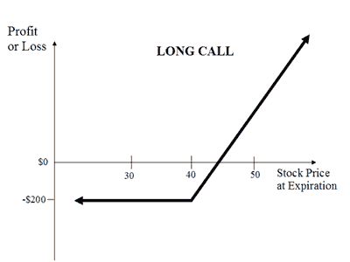
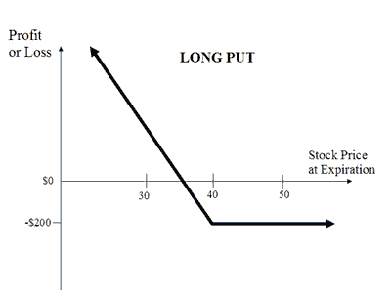
Review – Payoff Diagrams
Notes:
Notice that there is limited loss, why is this?
This is from the buyers perspective, what about from the seller’s perspective.
In this picture, how much did we pay per option (not per 100), what is the strike price? What would my pnl be if the stock was trading at 41? Where is my breakeven point?
What is the trick for finding breakevens (add per contract price to strike price = breakeven).

Slide 5
Review – Payoff Diagrams
Notes:
Unlimited loss/risk. Why would someone buy these? because you are on credit, you don’t need to put money down upfront for this position. Also for hedging, selling covered calls = income.

Slide 6
Review - Moneyness
Moneyness relates to how far above/below the strike price the underlying (and thus the option) is.
Out of the money (OTM) means that the underlying spot price (share price of the stock itself) is away from the share price towards the worthless direction (if the option expired today, it would be $0).
In the money (ITM) means that the underlying spot price (share price of the stock itself) is away from the share price towards the valuable direction (if the option expired today, it would still have intrinsic value).
At the money (ATM) means that the spot price is exactly at the options strike price (can think of this as between ITM and OTM).

Slide 7
Intrinsic vs Extrinsic Value
The Value of an option changes over time depending on a host of factors, we can divide this value into two components:
Intrinsic Value is simply what the option would be worth if we were to exercise it at this exact moment (i.e. the actual pnl you would make).
Extrinsic Value is the remainder of an options value besides the intrinsic value, this includes mainly time value of an option.
Extrinsic Value can also be thought of as the difference in the intrinsic value of an option (the value you know you can extract by exercising it), vs the price the option is trading at.
Notes:
For example, if I have a stock trading at $50 and a call with a strike price of $40, the intrinsic value of that option is $10. i.e. if I exercised it right now I would make $10, but does this mean that it is trading for 10 dollars. If it was

Slide 8
Options Calculator

Slide 9
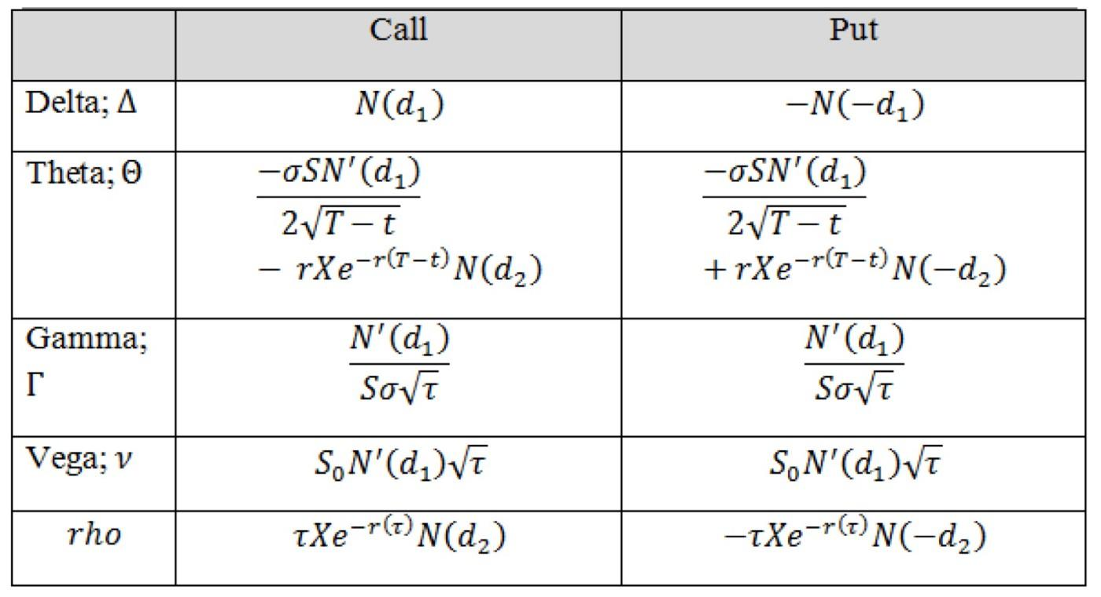
Black Scholes - Greeks
The greeks are a set of partial derivatives which describe the effect of different :

Slide 10
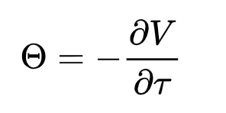
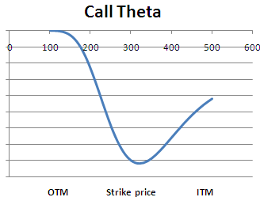
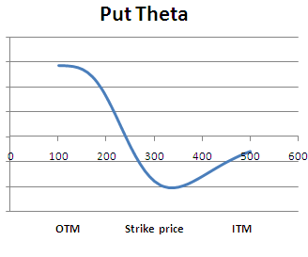
Greeks – Theta
Theta is the Change in the Price of an Option Relative to a 1 day passage of time.

Slide 11
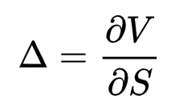
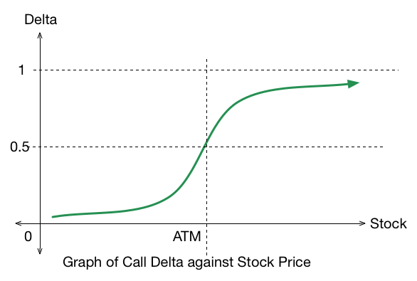
Greeks - Delta
Delta is the Change in the Price of an Option Relative to a $1 Movement in Spot.
Notes:
An ATM call has 0.5 delta, intuitively this is because it has a 50% chance of ending up ITM or OTM (in practice the reasoning is more complex)

Slide 12
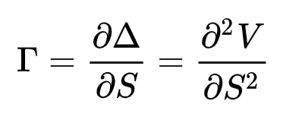
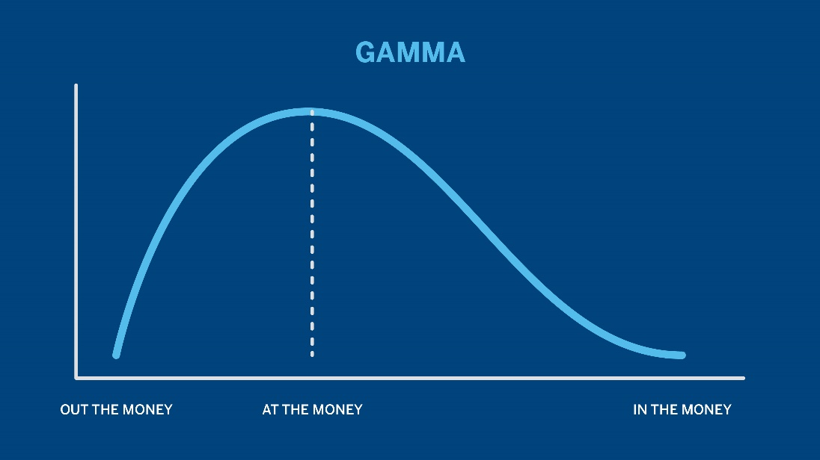
Greeks – Gamma
Gamma is the Change in the Price of an Option Relative to a change in delta.
Notes:
Just derivative of delta graph

Slide 13
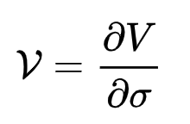
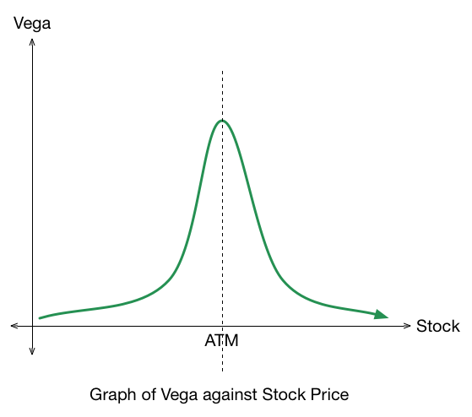
Greeks – Vega
Vega is the Change in the Price of an Option Relative to a 1% change in volatility.

Slide 14
What is volatility?
Statistically volatility is simply the standard deviation of an assets returns. Returns are just a way of tracking an asset’s performance over a given period.
We intuitively expect these returns to be normally distributed (events get less and less likely as they become more and more extreme).
In reality, our distributions are fat tailed (platykurtic/negative kurtosis) indicating more volatility/extreme events than a simple normal distribution.
Notes:
Options r always packaged to 100.
Make not of American vs euros also interesting other things ppl do with this like Asian options which payout the average price over the time period
Questions:
does it make sense to exercise an option early? When does it make sense to do so.
Lets say expiry day has come, so the past question is now irrelevant, when does it make sense to use your option. When does it not make sense?

Slide 15
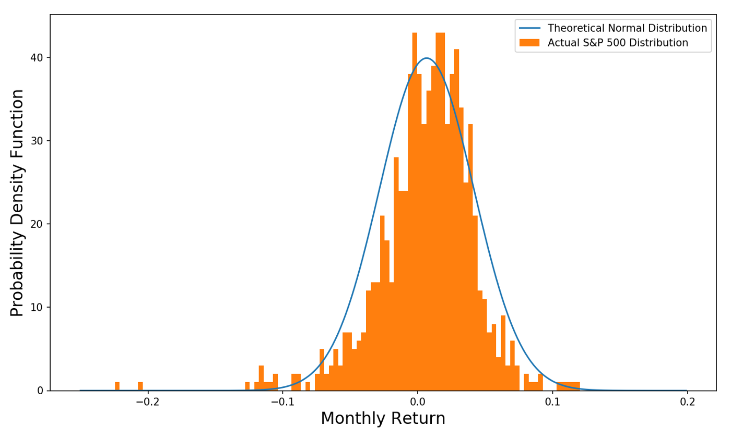
Normal Distribution of Returns
Notes:
Options r always packaged to 100.
Make not of American vs euros also interesting other things ppl do with this like Asian options which payout the average price over the time period
Questions:
does it make sense to exercise an option early? When does it make sense to do so.
Lets say expiry day has come, so the past question is now irrelevant, when does it make sense to use your option. When does it not make sense?

Slide 16
Deep Dive – Realized Volatility
Realized Volatility is a value calculated on top of spot prices which gives us a metric for past volatility. It is not forward looking which means it is solely based on past data.
Calculating realized volatility can be done in many ways but it is always based on a set statistical test/formula to determine a value from intraday prices, daily returns, overnight jumps, etc.
We can calculate realized volatility without options prices, it is only based on the spot value as our formulae are not dependent on forward looking options strikes.
Notes:
Options r always packaged to 100.
Make not of American vs euros also interesting other things ppl do with this like Asian options which payout the average price over the time period
Questions:
does it make sense to exercise an option early? When does it make sense to do so.
Lets say expiry day has come, so the past question is now irrelevant, when does it make sense to use your option. When does it not make sense?

Slide 17
Deep Dive – Implied Volatility
Implied Volatility is a value dependent on current options black Scholes prices for those options. As we know there are 5 inputs to BSM (spot, strike, expiry, rates, and vol), if we know 4 of these and the market price, we can derive an inverse function to imply the 5th
In practice this derivation is only really done for volatility hence why we call it ”implied volatility” as we are implying it from BSM.
This volatility is forward looking as it is attached to a strike and expiry date. It is quoted in percent terms where the percent corresponds to a 1 std dev move in price. For example, if spot is $100 and IV is 10% a 1 std dev move in prices implied by the market is from 90 - 110, which, of course, has a 68% probability.
Notes:
Options r always packaged to 100.
Make not of American vs euros also interesting other things ppl do with this like Asian options which payout the average price over the time period
Questions:
does it make sense to exercise an option early? When does it make sense to do so.
Lets say expiry day has come, so the past question is now irrelevant, when does it make sense to use your option. When does it not make sense?

Slide 18
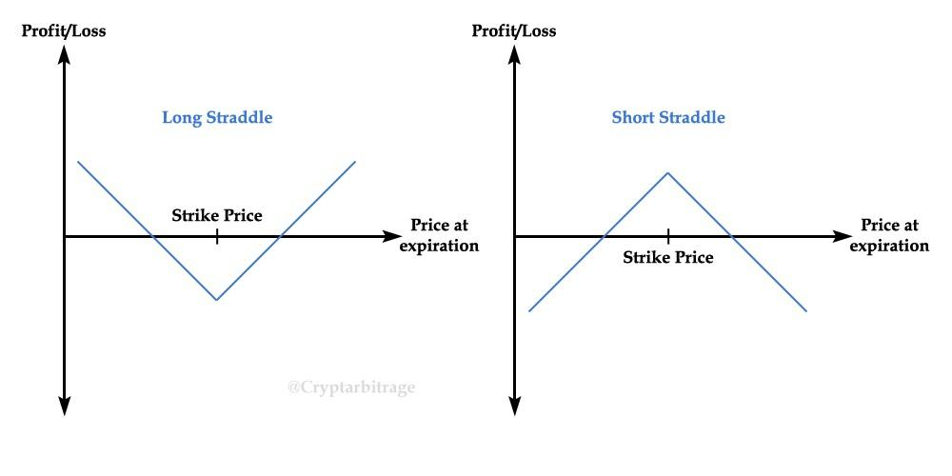
Trading Volatility
Straddles/Strangles are a way for us to express our view on volatility without a view in the underlying, it involves buying a call and a put the same distance from ATM. This is delta neutral at inception and is holding a lot of vega.
Notes:
Options r always packaged to 100.
Make not of American vs euros also interesting other things ppl do with this like Asian options which payout the average price over the time period
Questions:
does it make sense to exercise an option early? When does it make sense to do so.
Lets say expiry day has come, so the past question is now irrelevant, when does it make sense to use your option. When does it not make sense?

Slide 19
Payoff Diagrams - Call Spreads
Notes:
Unlimited loss/risk. Why would someone buy these? because you are on credit, you don’t need to put money down upfront for this position. Also for hedging, selling covered calls = income.

Slide 20
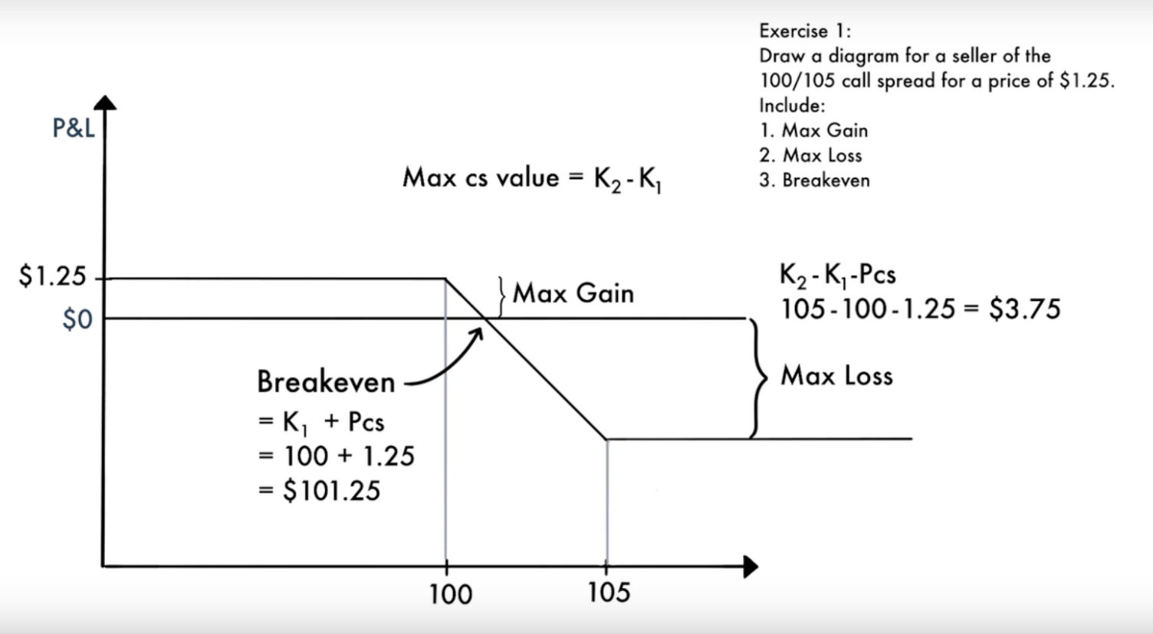
Payoff Diagrams - Call Spreads
Notes:
Unlimited loss/risk. Why would someone buy these? because you are on credit, you don’t need to put money down upfront for this position. Also for hedging, selling covered calls = income.

Slide 21
Thought Exercise
How much would you pay for Farook’s Halal cart? Walk us through how you would think about this.

Slide 22
What Is Valuation?
Determining how much a business is currently worth
Relies on assumptions of the business
Analyzes historical financials and projects future prospects
No exact number that everyone will agree on
Art, not a science

Slide 23
What are the primary types of valuation?

Slide 24
Types of Valuation
2 Major Types of Valuation
Relative Valuation
Values a company by comparing it to other similar companies in the same industry
Intrinsic Valuation
Values a company based on how much cash the business can generate

Slide 25
Relative Valuation

Slide 26
What Are You Comparing?
When doing relative valuation, we look for companies that are
In the same industry
Have similar business model / sell similar products
In the same geography
Around the same size

Slide 27
Thought Exercise
Back to the Farook’s:
What would you compare it to when trying to value it?

Slide 28
Thought Exercise
Back to the Farook’s:
What would you compare it to when trying to value it?

Slide 29
How Do You Compare?
Price that these other businesses are valued at
Eg. Halal Cart A store is valued at $100,000
Does this mean that Farook’s should also be valued at
$100,000?
If not, what are we missing?

Slide 30
Earnings!
Companies from the same industry can have different levels of profitability that we need to consider
If Halal Cart A makes $10,000 of earnings, and Farook’s makes $50,000, but they are both valued at $100,000 – is this fair?
Just based on this, which one would you rather invest in?
Why do you think we can see such a drastic difference between two companies in the same industry?

Slide 31
What is a Valuation Multiple?
A ratio of A/B
A is usually defined as price or value of the business
B is a financial metric of the company (Revenue, Earnings,
etc…)
Price / Net Earnings (P/E Ratio) is the most well-known multiple, but another valuation multiple is much more common

Slide 32
EV/ EBITDA
One of the most used multiples in relative valuation
Numerator: Enterprise Value
Value of the core operating assets of the business
EV = Equity Value + Debt – Cash
Considers both the debt and equity investors of a business
Denominator: EBITDA
Earnings Before Interest, Tax, Depreciation, and Amortization

Slide 33
Example
Halal Cart A
EV = $100
EBITDA = $20
EV/EBITDA = ?
Farook’s
EBITDA = $50
What should the EV be assuming that the two companies trade at the same multiple?

Slide 34
Comparable Companies Analysis
What you just did is a comparable companies valuation!
In practice, you would find the multiple for a group of comparable companies (other Halal carts) and find the median/mean
Can also use other multiples besides EV/EBITDA
Company is worth what the market will pay for it

Slide 35
Precedent Transactions Analysis
Similar to comparable companies analysis except that you use historical transactions
Eg. Use a list of halal carts that have been acquired in the past and see at what multiple they were acquired at

Slide 36
Intrinsic Valuation

Slide 37
Intrinsic Valuation
Based on a company’s ability to bring in cash
Valuation doesn’t reference the market value
Most popular form of intrinsic valuation:
Discounted Cash Flow Analysis (DCF)

Slide 38
Time Value of Money
Let’s say you are working a job that pays you $100 a week.
Would you rather be paid now? Or in a year? Why?

Slide 39
Time Value of Money
Let’s say you are working a job that pays you $100 a week.
Would you rather be paid now? Or in a year? Why?
Now!
Opportunity Cost! Money received today can be invested and you can earn interest on it.
Less Risk

Slide 40
Discounted Cash Flow Analysis (DCF)
Value of a firm equals the present value of future cash flows
Values a company based on how much cash it generates in the future
Cash generated next year will be worth more than cash generated 5 years from now

Slide 41
Formula for FCF
Revenue
(-) COGS
Gross Profit
(-) Operating Expenses
EBIT
(-) Cash Taxes
(+) Depreciation
(-) Changes in Net Working Capital
(-) Capital Expenditures
Unlevered Free Cash Flow

